Slide 1
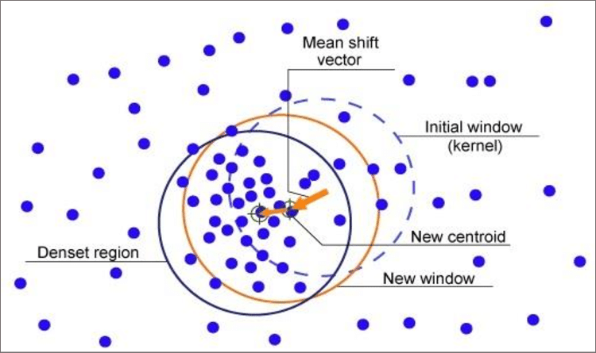
Mean Shift Clustering Algorithm
Non-Parametric Algorithm

Slide 2
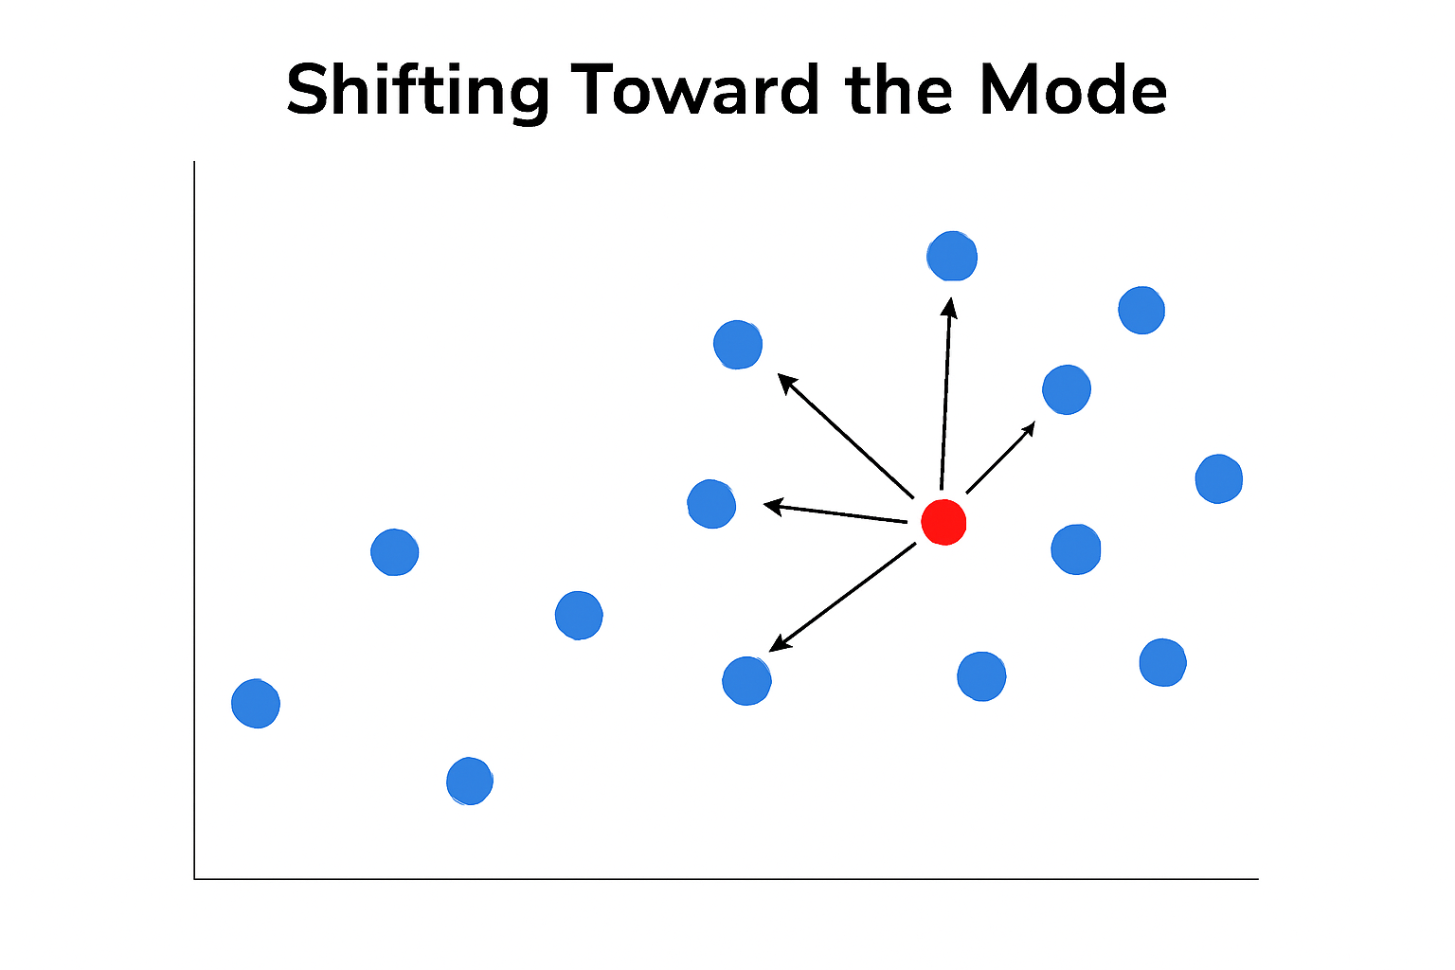
Mean shift clustering finds clusters by iteratively shifting data points toward the densest regions in the feature space.
Concepts to Understand mean Shift:
Clustering: Grouping data points based on similarity.
Non-parametric algorithm: An approach that does not require specifying the number of clusters beforehand.
Kernel Density Estimation (KDE): A statistical technique to estimate the probability density function of a random variable, critical for mean shift’s operation.
Mean Shift Vector: A vector computed for each data point to point towards the densest region nearby.
Convergence: The process whereby iterative shifts of points stabilize, revealing cluster centers.

Slide 3
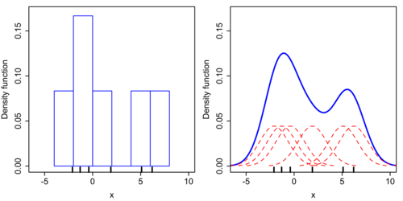
Kernel Density Estimation (KDE):
The movement of data points in mean shift clustering is governed by Kernel Density Estimation (KDE), a technique used to estimate the underlying distribution of data points:
Each data point is shifted towards the nearest peak in the density function. For example, a data point with a value near 1 will be pushed towards the closest density peak near 1, while another near 3 moves towards the density peak around 3.
This shifting toward density peaks enables the clustering process to identify natural groupings without predefined cluster counts.

Slide 4
The Mean Shift Clustering Algorithm: Step-by-Step
Initialization:
Each data point is initially considered as assigned to a cluster
Iteration
Steps 2 and 3 are repeated until convergence, i.e., when data points move insignificantly between iterations, indicating local maxima of the density function have been reached.
Mode Seeking (Mean Shift Vector Calculation):
For each data point, the mean shift vector is calculated. This vector points toward the densest region in the point’s local neighbourhood. It is computed as a weighted average of offsets between the current point and other points within a defined bandwidth.
Cluster Formation
Data points that converge to the same location are grouped into the same cluster.
Update Centroids
Data points are shifted along their respective mean shift vectors toward regions of higher density.

Slide 5
from sklearn.cluster import MeanShift from sklearn.datasets import make_blobs mean_shift = MeanShift() mean_shift.fit(X)
Advantages | Disadvantages | Uses
Non-Parametric | Computational Cost | Image Segmentation
Shape Adaptability | Bandwidth Sensitivity | Object Tracking
Minimal Assumptions | Lack of Scalability | Anomaly Detection
Robust for uneven clusters | High-Dimensional Struggles | Spatial Data Analysis

